Slide 1
Arianna Privato
ML Project
How can we protect ourselves and our children from dangerous comments online?
Detecting Cyberbullying with NLP

Slide 2
What is Cyberbullying?
Reasons | Percentage of Cyberbullying
Appearance | 61%
Academic Achievement | 25%
Race | 17%
Sexuality | 15%
Financial Status | 15%
Religion | 11%
Other | 20%
Cyberbullying involves repeatedly posting offensive content about someone on social media or other websites, including spreading lies through live-streaming apps, group texts, and social media. The goal is to make the victim feel anxious, angry, depressed, embarrassed, scared, sad, or even suicidal.
Reasons for Cyberbullying

Slide 3
Did you know?
What can You do about it?
60% of all internet users have been cyberbullied, harassed, or abused online.
https://stopcyberbullyingday.org/
69% of those who admitted to cyberbullying have also disclosed that they have bullied others in person.
Florida Atlantic University
64% of students who have been cyberbullied say it affects their ability to learn and feel safe at school.
Cyberbullying Research Center

Slide 4
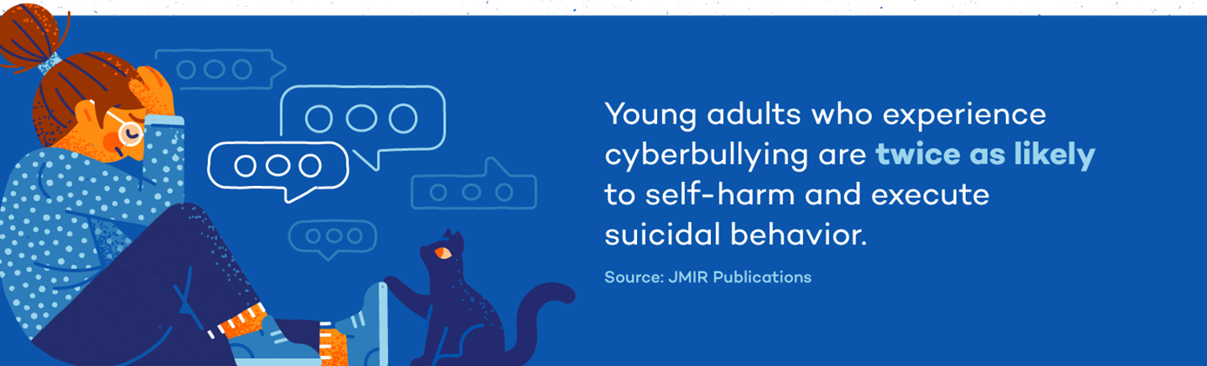
Consequences
68% of children that have gone through online harassment have experienced mental health issues.
The effects of the vice include stress, depression, anxiety, and loss of empathy, amongst others.
Cyberbullying

Slide 5
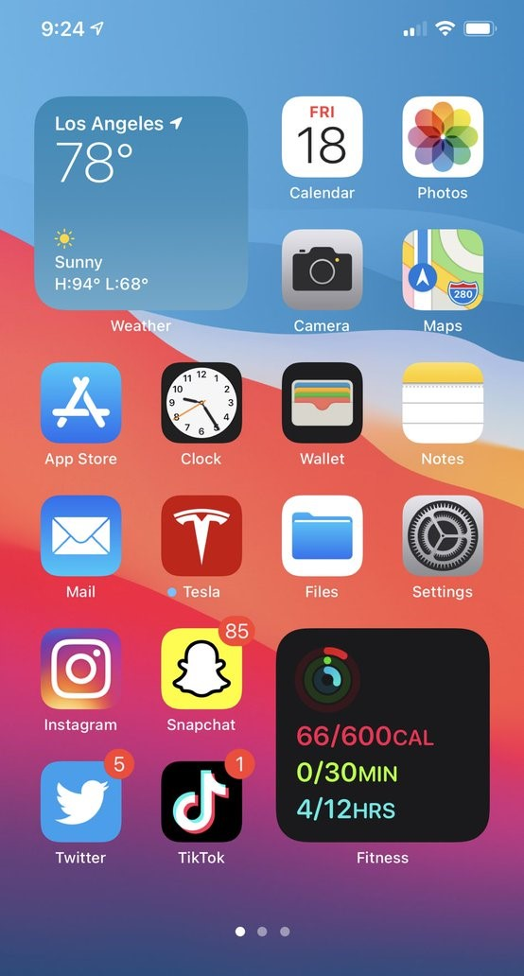
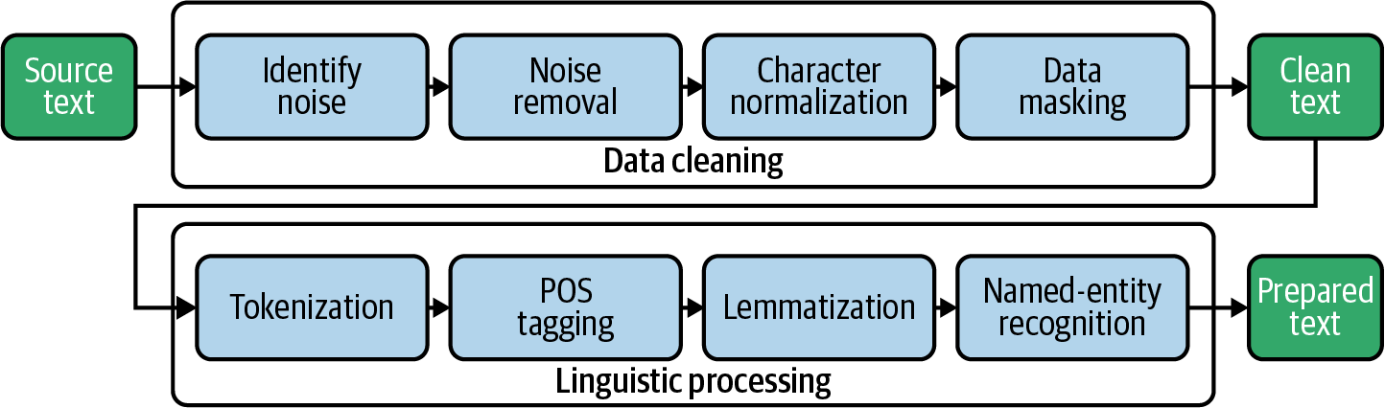
INTRO
NLP
Text cleaning

Slide 6
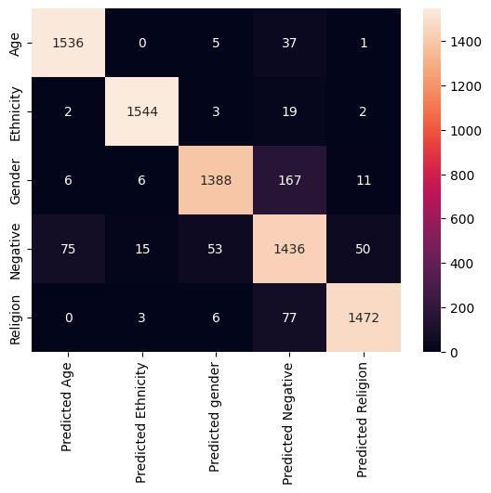
LINEAR MODEL
MODEL
1
93%
Accuracy

Slide 7

LSTM MODEL
MODEL
2
94%
Accuracy

Slide 8

TRANSFORMERS MODEL
MODEL
3
93%
Accuracy

Slide 9
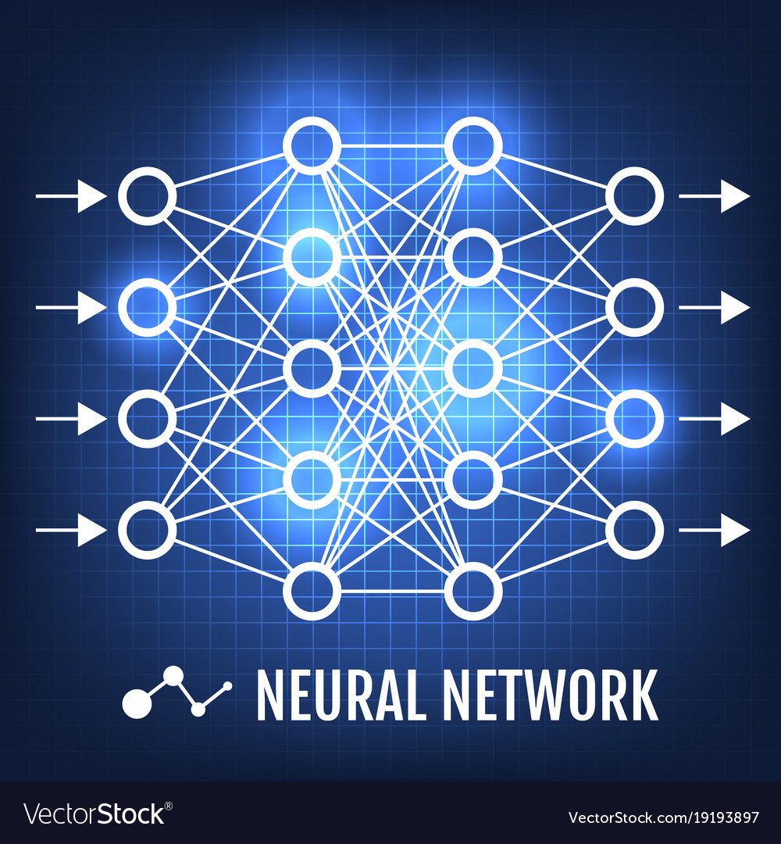
CONCLUSIONS
BEST RESULT: LSTM MODEL
94% ACCURACY

Slide 10
THANK YOU
Feel free to ask questions

